Slide 1

The Essential
Agreement
THRIVE Lessons

Slide 2
Learning Objectives
Understand that stress isn’t always bad.
Explore ways to respond to stress. (Stress Resilience)
Apply the stress bucket to manage stress effectively.
In today’s lesson, you will…

Slide 3


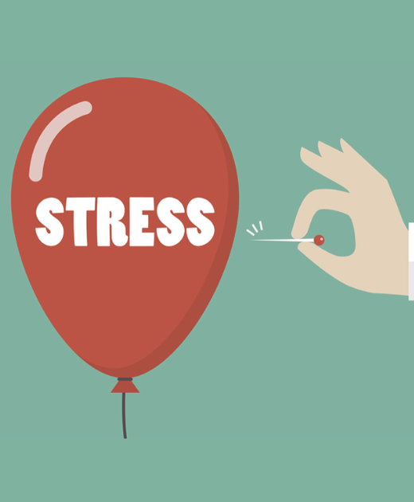
These lessons have been developed by a team from the University of Oxford (Departments of Clinical Neuroscience, Experimental Psychology, and Psychiatry), with involvement from teachers and young people. This project was funded in part by the University of Oxford Enriching Engagement scheme.

Slide 4


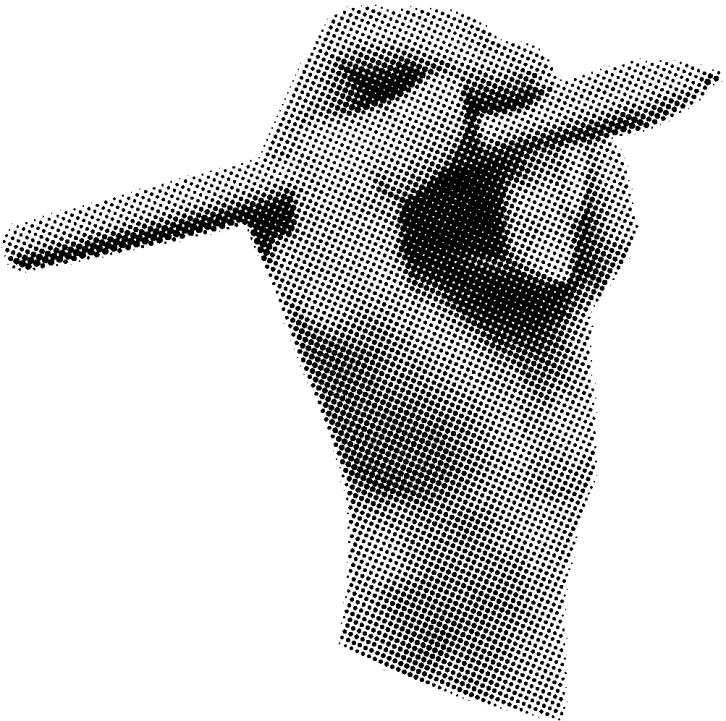
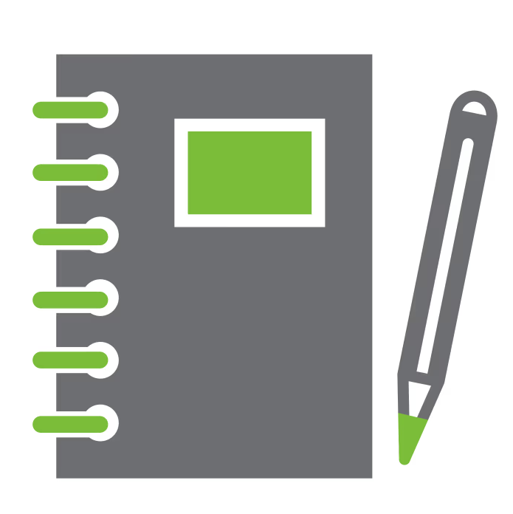

Baseline –
Student Questionnaire
Student Questionnaire" Complete this independently. You will not be asked to share your answers.

Slide 5


Training the brain to cope with stress
Stress can feel bad....
BUT learning to respond well can help people feel better
AND train their brains to cope better with stress in future.
Watch this video and make notes in the next slide key tips
https://vimeo.com/874358621

Slide 6
Training the brain to cope with stress
Your notes…
learning to respond to it well can help us to feel better
can help to train our brain so that we cope better with stress in the future.
aims to engage teenagers with evidence-based science and practices of stress resilience.
If we face stress head on, our brains become stronger and better able to cope to change
Stress gives us energy and focus helping us to concentrate and boost our skills
Coping with stress is a skill we can learn
The part of brain that controls stress is called: prefrontal
https://vimeo.com/874358621

Slide 7
Scenario: How others can help….
Date/Time | What was your friend stressed about? | What did you do to help? | How did they feel afterwards? | How did you feel afterwardS? | How did it go / what happened next?
Wed, lunchtime | My friend Amber really wants to audition for the school production but is worried about messing up and being judged. | We went to the music rooms at school, and she practiced her audition in front of me. | She felt pleased she did it and more confident for the actual audition. | I felt good that I had supported her and helped her feel more confident. | She was nervous to begin with, and we kept laughing. But then she did it properly and it was really good. She’s signed up for the auditions so hopefully she’s going to go for it!
Do you know someone who handles stressful situations well? What do they do?

Slide 8
Do you know someone who handles stressful situations well? What do they do?
My friend in my primary school always got low grades and a lot of classmates laughed at him, he didn’t feel sad and started studying more and being more focused in classes. Then he got good grades and the other classmates were surprised.
Answer here.

Slide 9

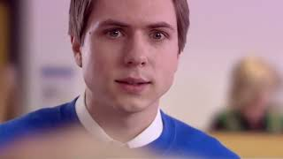
How stressful would this situation be for you? Can you relate to this?
Notes:
https://youtu.be/D3_uwoph_Vo?si=CNSZvO3aWpm3T8GD

Slide 10
Answer here
Notes:
https://youtu.be/D3_uwoph_Vo?si=CNSZvO3aWpm3T8GD

Slide 11
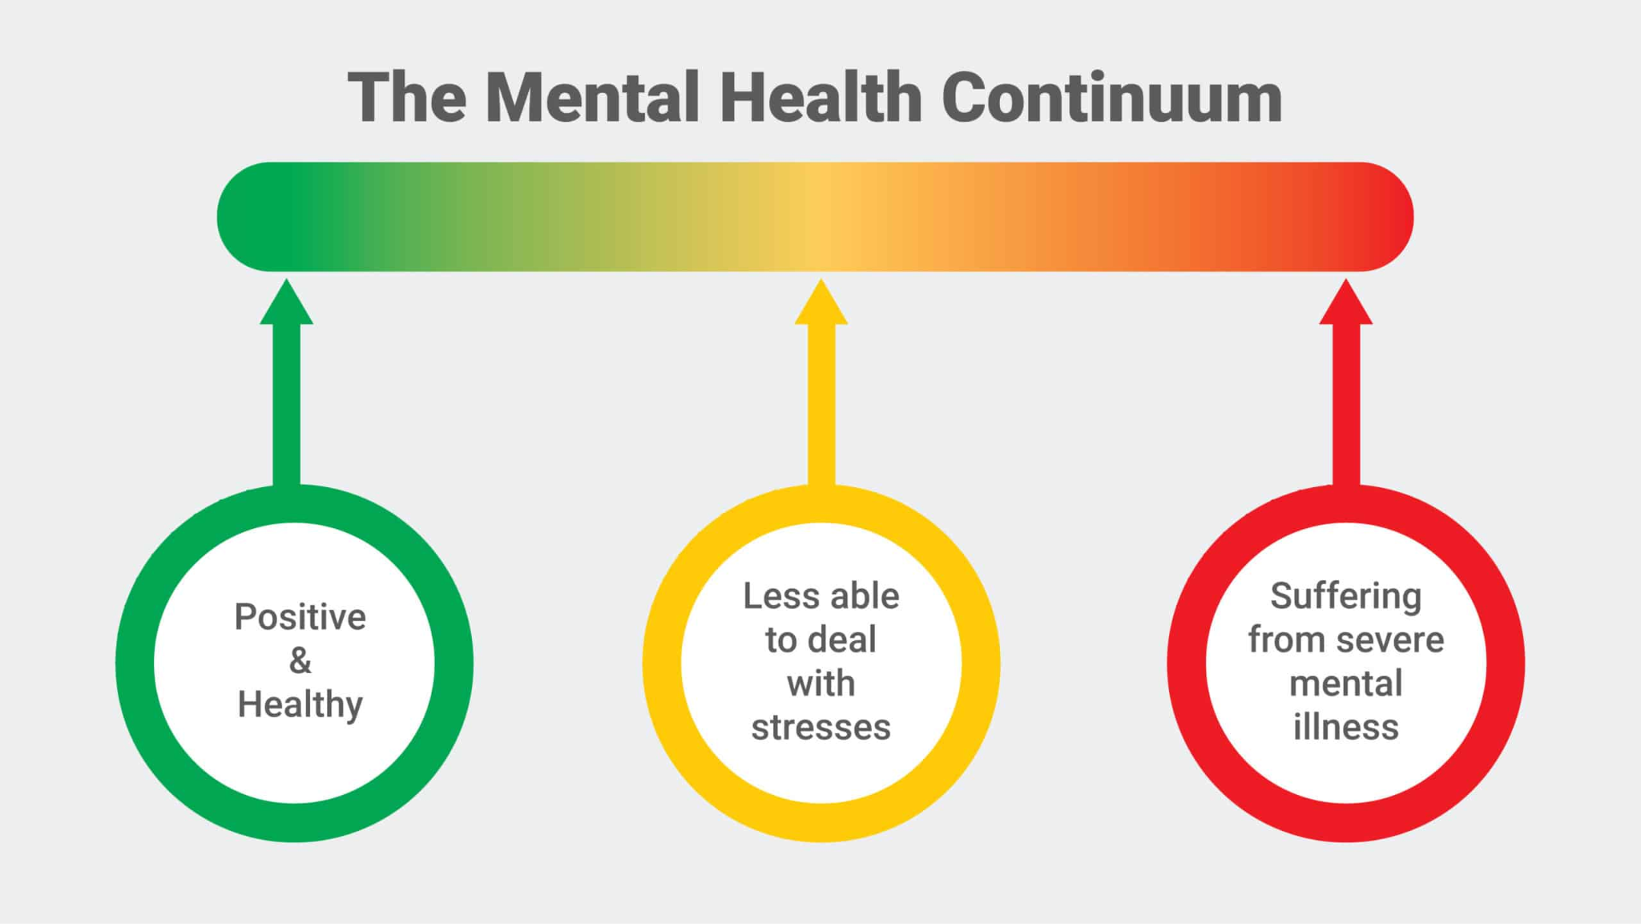
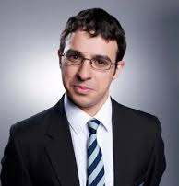
S T R E S S M E T E R
It’s hard but I find ways to cope
Often the stress gets to me
I really struggle

Slide 12
Where does Will sit on this stress meter?
S T R E S S M E T E R
It’s hard but I find ways to cope
Often the stress gets to me
I really struggle

Slide 13

A stress sweet-spot
BRAVE?
Performance
The Yerkes-Dodson effect shows that people need just the right amount of stress to perform at their best.
Not too much or too little.
Arousal (stress)

Slide 14
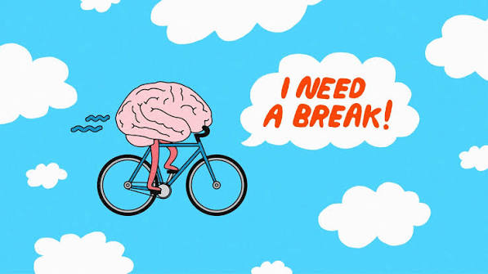
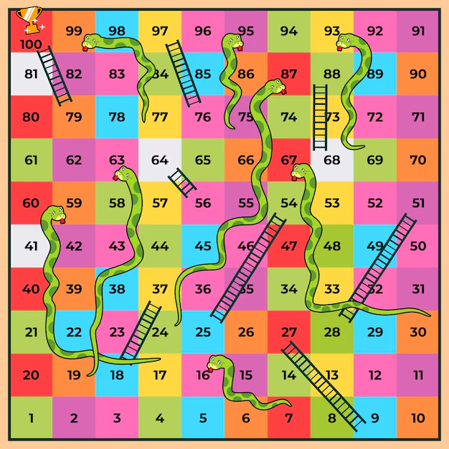
A 2017 study suggests playing board games can help lower stress and increase feelings of calmness.
Playing board or card games also helps in improving cognitive skills like problem-solving, decision-making, and critical thinking.
Engaging in such activities keeps your mind off stress for a few hours, and you can fully focus on the game, its rules, and strategies

Slide 15

What makes people more resilient than others?
The million-dollar question:
Scientists still do not fully understand, but stress response depends on a complex interplay of various factors.
External Factors
Resilience is influenced by broader contexts including social, economic, and environmental factors.
Individual Level
Sensitivity to stress varies. Even highly sensitive individuals can show great resilience in challenging situations.
Key Contributors
Early childhood
Social relationships
Leading an active life

Slide 16
What do YOU think makes some people more resilient than others? Do you consider yourself more resilient than others? If so, why? If not, why not?
Answer here:
I am not a resilient person because big changes sometimes feel overwhelming, making it a bit difficult

Slide 17
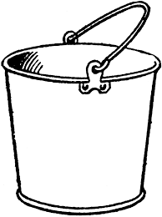
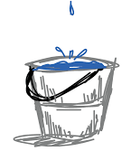

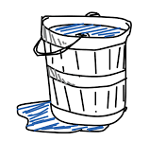


Buckets of Stress Resilience
This is a stress bucket.
Imagine stresses and worries pour in.
Everyone’s bucket can hold different amounts.
But if it reaches the top,
it may feel overwhelming and
hard to manage.

Slide 18
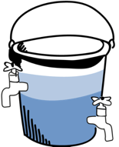
Buckets of Resilience
These activities and habits help the brain circuits function well and support learning.
Exercise
Enjoyable
activities
Healthy eating
Starting new activities can feel scary (that's the brain talking) but they can make a big difference to mental well-being.
Enough sleep
Time with friends
& Family
Sometimes though that bucket will overflow and there is nothing that can be done to stop it, and that is OK and happens to everyone.
So it is good to be brave and face fears! Find a good balance between the limbic system and prefrontal cortex.

Slide 19
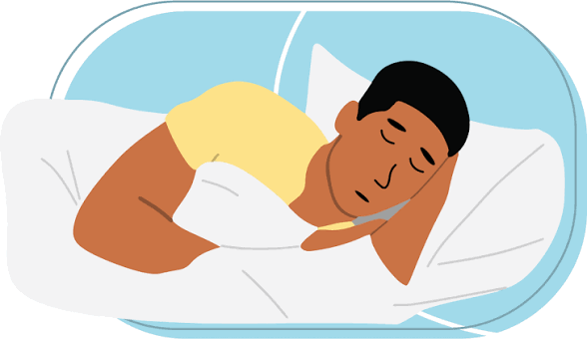

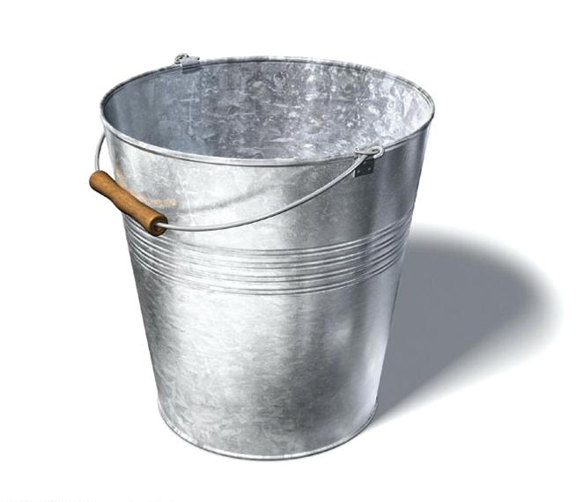

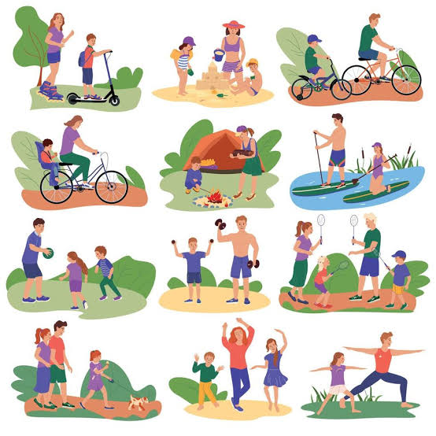

Build you own bucket of resilience (mood board)

Slide 20
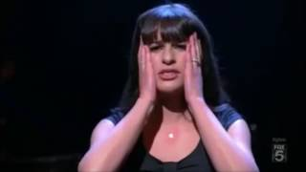
Scenario :Audition or sporting trial failure
Picture yourself as Rachel, feeling mortified after a bad audition. Or, if you're athletic, imagine failing miserably at a sports trial where all your friends make the team except for you. What could you do?
Notes:
https://youtu.be/VEQyJgscurA?si=bBN06LFvYvNKdLqU

Slide 21
Scenario :Audition or sporting trial failure
Answer here:
Notes:
https://youtu.be/VEQyJgscurA?si=bBN06LFvYvNKdLqU

Slide 22

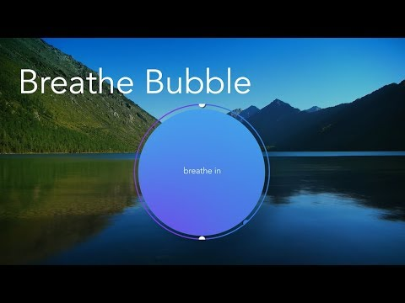
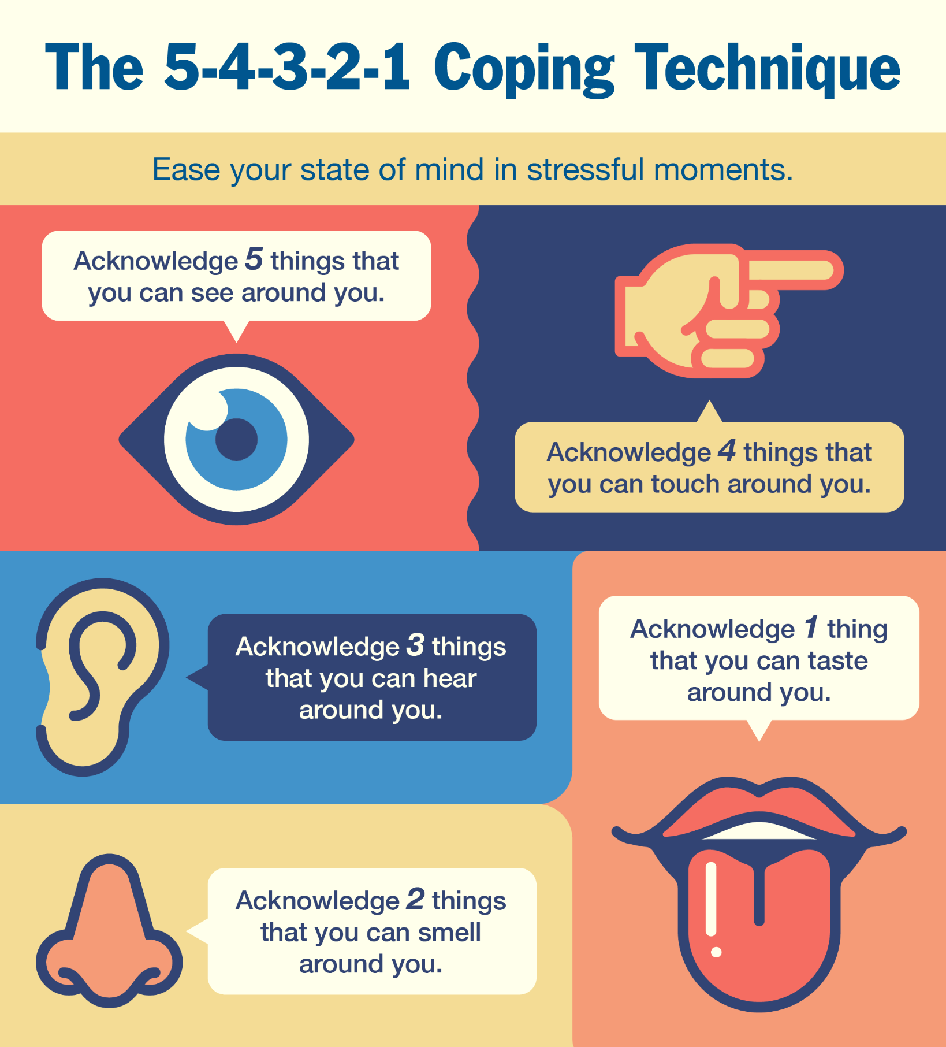

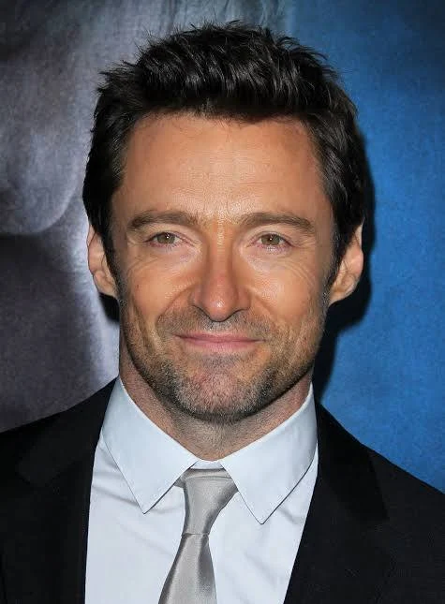

STRATEGIES
The "5-4-3-2-1" Technique: An effective activity to calm the "Feeling Brain" when emotions are high. Justin Bieber uses the 5-4-3-2-1 sensory method during panic.
Deep breathing: calm your brain down by calming the physical symptoms of anxiety. Well-known figures like Oprah Winfrey, Hugh Jackman and Katy Perry practice meditation

Slide 23
Find another scenario
Attach video here:

Slide 24
Elaborate on another strategy to deal with the scenario
Answer below:

Slide 25
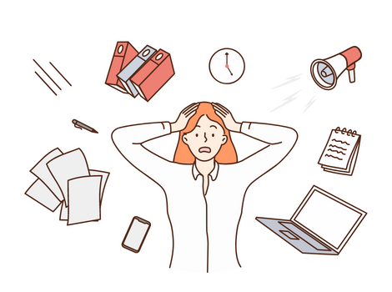
Plenary
Stress is a normal part of life, but everyone experiences it differently and can handle different levels. The first step to managing stress is to understand what triggers it for you.
Complete the Google Form ready for the presentation next week from the counselling team.

Slide 26
SUBMIT TO TODDLE ONCE YOU’RE DONE!

